Slide 1



Log in
Secure Login
Please log in with your Investec Online Password
Password
Need Assistance
+27 11 286 9663
App version 2.12.0
Log In

Slide 2
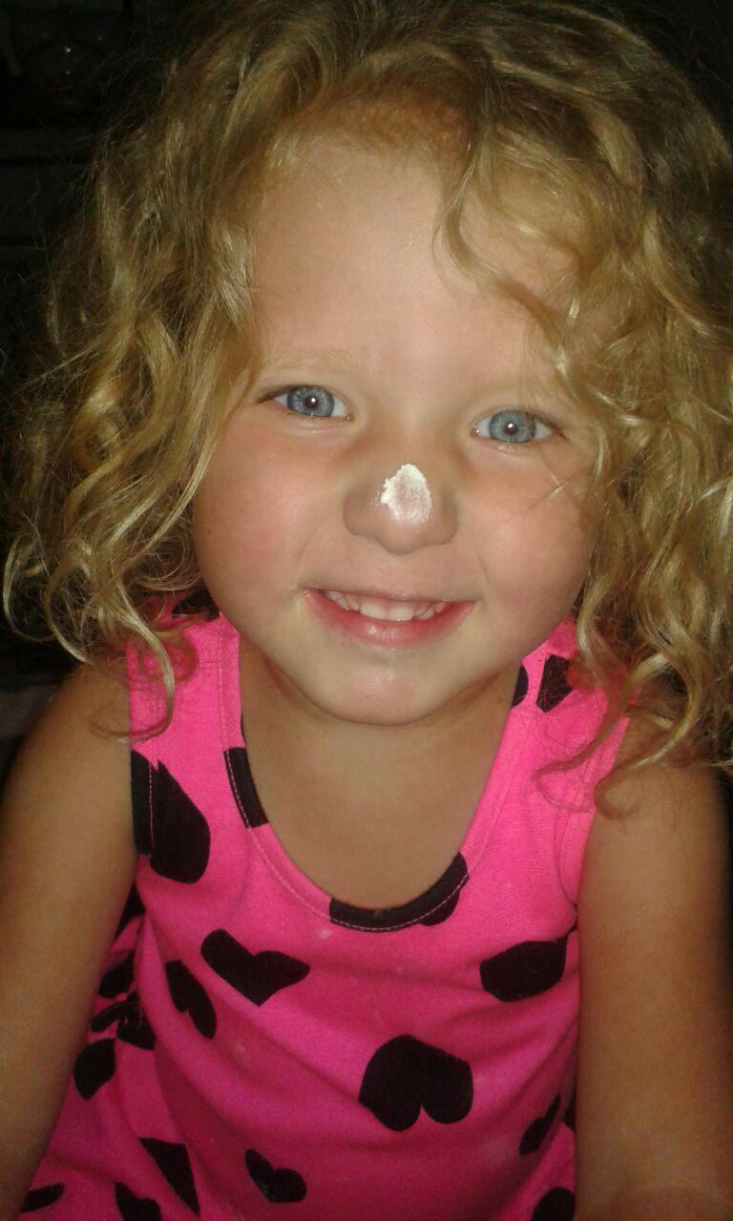
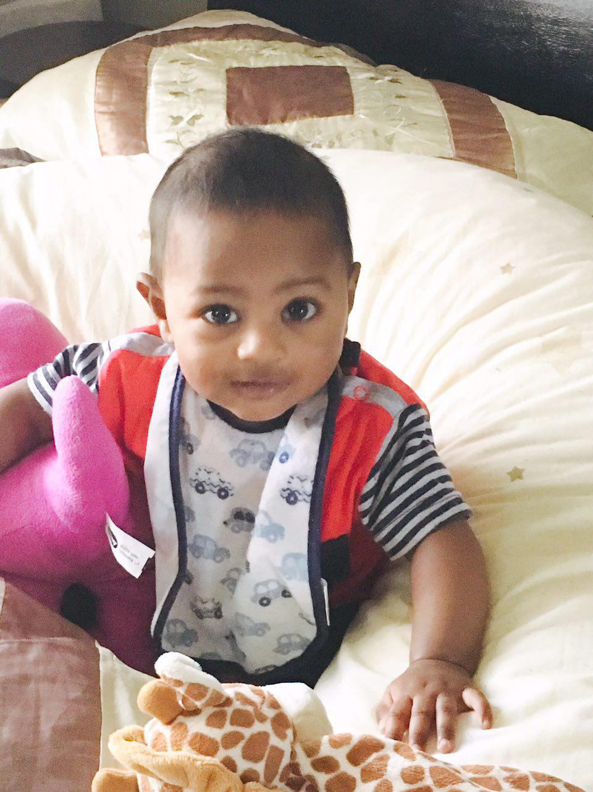
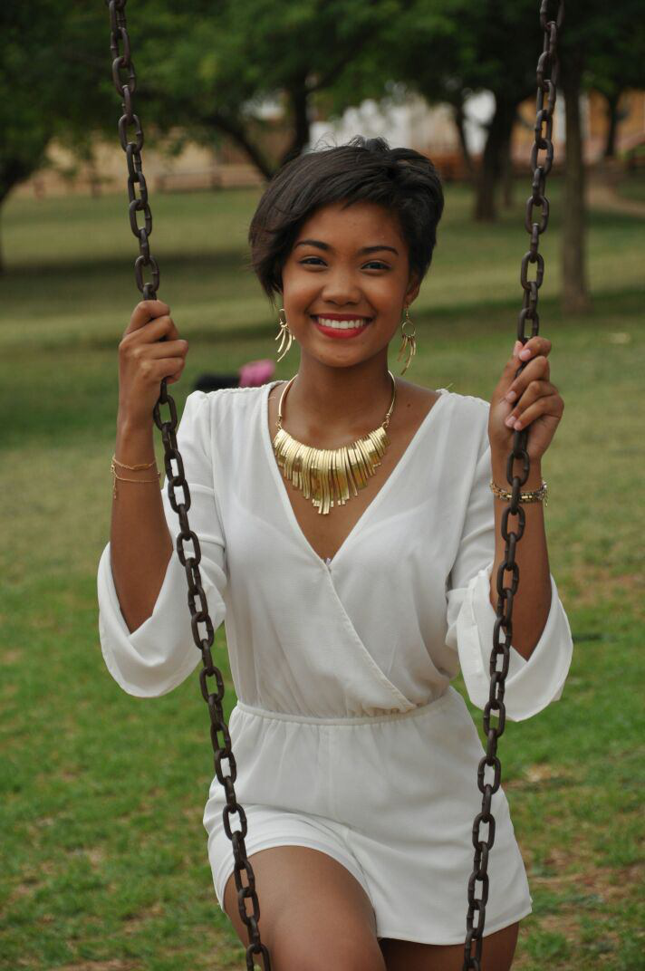
Hello Mr. Stan Smith
Investec Account
1001xxxxxxxxxxxx
Available Balance
R5xxxxxxxx
Make a Payment
Mika
Balance
R5xxxxxxxx
Kayleb
Balance
R5xxxxxxxx
Amelia
Balance
R5xxxxxxxx

Slide 3



Hello Mika
Investec Account
1001xxxxxxxxxxxx
Available Balance
R5xxxxxxxx
Chores

Slide 4


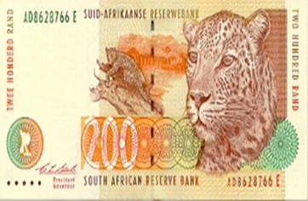

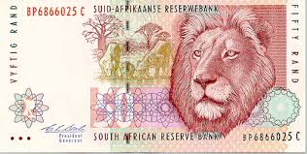
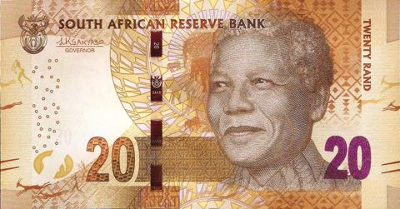

Hello Mika
Investec Account
1001xxxxxxxxxxxx
Available Balance
R5xxxxxxxx
X Box Goal = R4000
75%
50%
25%

